Slide 1

IS YOUR HOUSE BUILT ON A SOLID FOUNDATION?
你的房子是否建造在堅固的根基上？
Matthew 馬太福音 7:24-27

Slide 2
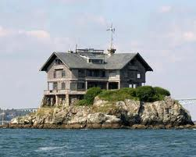
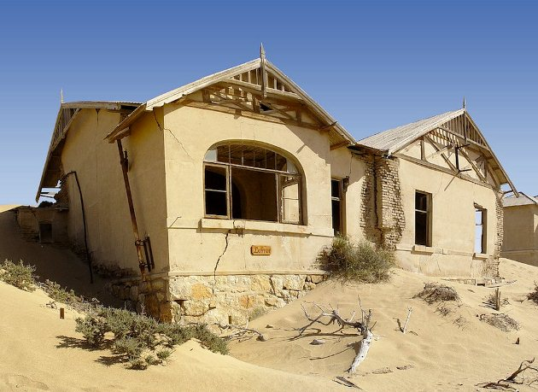
Two Builders
兩個蓋房子的人
The foundation matters!

Slide 3
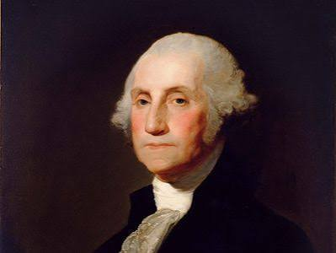
I. REMEMBER THE FOUNDATION
記住根基
George Washington, 1st President of the USA,
喬治．華盛頓, 美國第一任總統
“One should always be loyal to his country, but it should be our highest glory to be Christian.”
「一個人應當忠於自己的國家，但他最大的榮耀，是成為一位基督徒。」

Slide 4
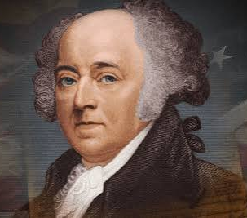
I. REMEMBER THE FOUNDATION
一、記住根基
John Adams, 2nd President of the USA
約翰．亞當斯, 美國第二任總統
“Suppose a nation should take the Bible for their only law Book, and every member should regulate his conduct by it. Every member would be obliged to justice, kindness, and charity towards his fellow men; and love and reverence toward Almighty God.”
「假如一個國家以《聖經》作為唯一的法律，每一位人民都按著聖經來規範自己的行為，他們必定會公平、仁慈、憐憫待人，並敬愛全能的上帝。」

Slide 5
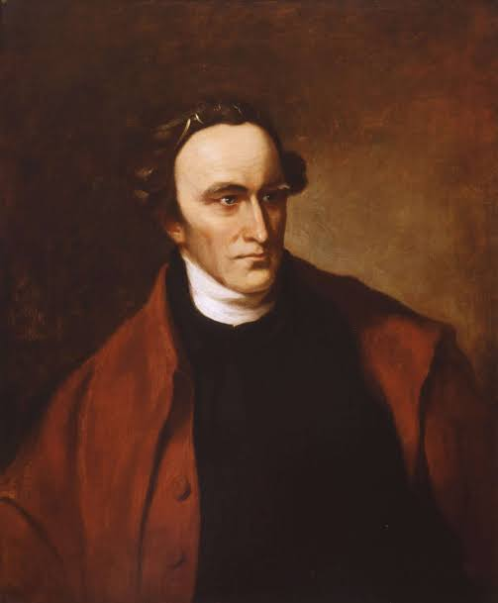
I. REMEMBER THE FOUNDATION
記住根基
Patrick Henry, Governor of Virginia
派翠克．亨利, 維吉尼亞州州長
“It cannot be emphasized too strongly or too often that this great nation was founded by Christians; not on religions, but on the gospel of Jesus Christ. For this very reason peoples of other faiths have been afforded protection, prosperity, and freedom of worship here."
「再怎麼強調也不為過：這個偉大的國家是建立在基督徒的信仰上，不是建立在宗教之上，而是建立在耶穌基督的福音上。正因如此，其他宗教信仰的人也能在這裡享有保障、繁榮與敬拜自由。」

Slide 6
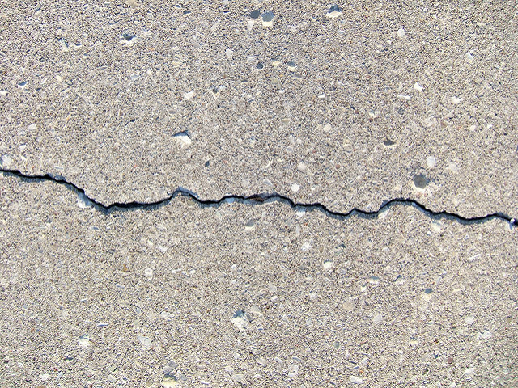
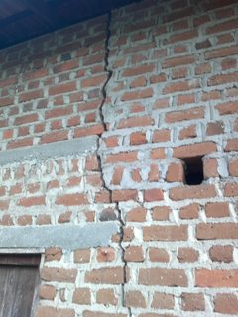
II. REALIZE THE CRACKS
二、認清裂縫

Slide 7
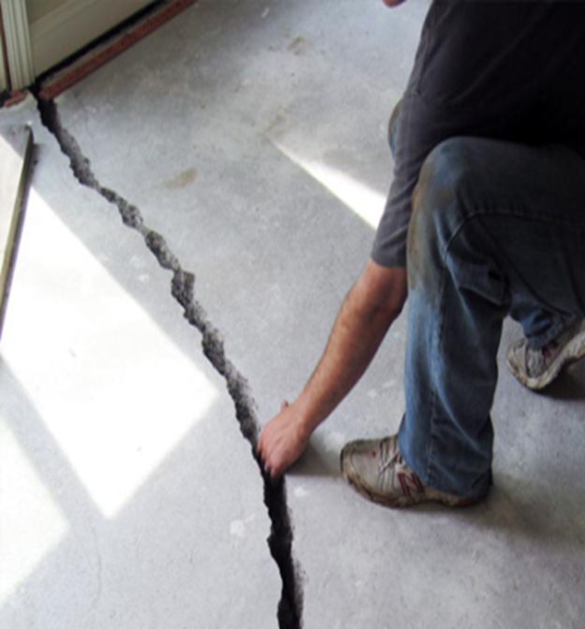


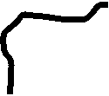




II. REALIZE THE CRACKS 二、認清裂縫
Spiritual fulfillment in any religion
認為任何宗教都能帶來屬靈滿足
Redefining marriage
重新定義婚姻
Easy divorce
輕率離婚
Tolerance over truth
寬容凌駕於真理
Education over character
教育勝過品格
Career over family
事業重於家庭

Slide 8
III. Restore the Foundations
三、重建根基
“If the foundations are destroyed, what can the righteous do?” Psalm 11:3
「根基若毀壞，義人還能做什麼呢？」詩篇 11:3

Slide 9
III. Restore the Foundations
三、重建根基
“If My people, who are called by My name, will humble themselves and pray and seek My face and turn from their wicked ways, then will I hear from heaven and will forgive their sin and will heal their land.” 2 Chronicles 7:14
「這稱為我名下的子民，若是自卑、禱告、尋求我的面，轉離他們的惡行，我必從天上垂聽，赦免他們的罪，醫治他們的地。」歷代志下 7:14
_______
___________
________

Slide 10
Restoring our Families
重建我們的家庭
“There is a way that seems right to man, but the end leads to death.” Prov. 14:12
「有一條路，人以為正，至終成為死亡之路。」
箴言 14:12

Slide 11
Restoring our Families
重建我們的家庭
“Unless the LORD builds the house, its builders labor in vain. Unless the LORD watches over the city, the watchmen stand guard in vain.”
Psalm 127:1
「若不是耶和華建造房屋，建造的人就枉然勞力；若不是耶和華看守城池，看守的人就枉然警醒。」詩篇 127:1

Slide 12
Restoring our Families
重建我們的家庭
We find spiritual fulfillment only in Jesus.
真正的屬靈滿足只能在耶穌基督裡找到。
Jesus said, “I am the way, the truth and the life, no one comes to God except through Me.” John 14:6
耶穌說：我就是道路、真理、生命；若不藉著我，沒有人能到父那裡去。」約翰福音 14:6

Slide 13
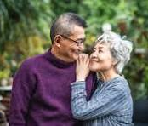
Restoring our Families
重建我們的家庭
God’s ideal for marriage
神對婚姻的心意

Slide 14
Restoring our Families
重建我們的家庭
“Haven’t you read,” Jesus replied, “that at the beginning the Creator made them male and female. For this reason a man will leave his father and mother and be united to his wife, and the two will become one flesh. So they are no longer two, but one flesh.” Matthew 19:4-6
耶穌回答說：「那起初造人的，是造男造女，並且說：『因此，人要離開父母，與妻子連合，二人成為一體。』既然如此，夫妻不再是兩個人，乃是一體的了。」馬太福音 19:4-6

Slide 15
Restoring our Families
重建我們的家庭
God’s goal of true education
神對教育的真正目的
“Seek first the kingdom of God and His righteousness and all these things will be added to you.” Matthew 6:33
「你們要先求他的國和他的義，這些東西都要加給你們了。」馬太福音 6:33

Slide 16
Restoring our Families
重建我們的家庭
God’s purpose in our work
神對工作的旨意
“And whatever you do, whether in word or deed, do it all in the name of the Lord Jesus…” Colossians 3:17
「無論做什麼，或說話或行事，都要奉主耶穌的名，藉著祂感謝父神。」歌羅西書 3:17

Slide 17
God’s questions about our foundation
神要問我們有關根基的問題
Job title or job integrity?
我們看重的是職位，還是工作的品格？
Success or service?
我們追求的是成功，還是服事他人？
House or hospitality?
我們重視的是房子，還是接待人的心？

Slide 18
God’s questions about our foundation
神要問我們有關根基的問題
Fashion or generosity?
我們更在意的是時尚打扮，還是慷慨分享？
Right neighborhood or being the right neighbor?
我們更在乎住在好社區，還是成為一位好鄰舍？

Slide 19
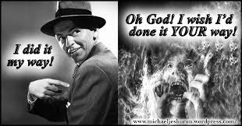
God will question our foundation
神要問我們有關根基的問題
Your way or God’s way?
你選擇的是自己的道路，還是神的道路？

Slide 20

Research on church attendance
建立穩固根基的研究
1. People who attend worship services are less depressed and physically healthier than their peers with no religious faith.
經常參加敬拜的人，比沒有宗教信仰的人較少憂鬱， 身體也更健康。
2. People who go to church have lower blood pressure.
經常聚會的人，血壓普遍較低。
3. People who do not attend church are four times more likely to commit suicide than are frequent church attenders.
不參加教會的人，自殺的可能性約是經常聚會者的四倍。

Slide 21
Research on a church attendance
建立穩固根基的研究
4. Church attendance is the most important predictor of marital stability.
是否穩定參加教會，是婚姻穩定最重要的預測因素之一
5. The greater a person’s religious commitment, the less likely he/she will abuse drugs.
  一個人的信仰越堅定，越不容易濫用毒品。
6. Alcohol abuse is highest among those with little or no religious
commitment.
酒精濫用最普遍的是那些幾乎沒有或沒有宗教信仰的人。

Slide 22
Research on health
建立穩固根基的研究
. 7. Mothers and their newborn babies have fewer medical complications if the mothers have a religious commitment.
有信仰的母親及其新生兒，通常有較少的醫療併發症。
8. Heart surgery patients with strong religious beliefs are much more likely to survive surgery and recover quicker from that surgery than patients with no religious beliefs.
擁有堅定宗教信仰的心臟手術病人，比沒有信仰 的人更容易存活，且恢復得更快。

Slide 23
“The fear of the Lord adds length to life.
Proverbs 10:27
「敬畏耶和華，使人日子加多。」箴言 10:27
The most important factors of human happiness and well-being are
人生幸福與身心健康最重要的因素之一，就是
our spiritual beliefs and moral choices.
屬靈信仰與道德選擇。

Slide 24
REMEMBER WHAT MAKES A FIRM FOUNDATION
記住什麼是真正穩固的根基
RECOGNISE THE CRACKS THAT HAVE OCCURRED IN THAT FOUNDATION
認清根基已經出現的裂縫
RESTORE THE CRACKED FOUNDATIONS.
修復已經受損的根基

Slide 25
The foundation in Jesus Christ…
在耶穌基督裡的根基……
will enable our marriages to endure.
能使我們的婚姻堅固長久。
will encourage our children to better take hold of the Christian faith themselves.
能幫助我們的兒女建立自己的基督信仰。
will show us God’s path for our lives.
能引導我們走在神為我們預備的人生道路上。

Slide 26
The foundation in Jesus Christ…
在耶穌基督裡的根基……
will instruct our moral choices in life.
引導我們作出合神心意的道德選擇。
will help us decide what priorities are best for our family.
幫助我們分辨家庭真正重要的優先次序。
will guide us when our family has problems and needs to make important decisions.
在家庭面對困難與重大決定時，引導我們前面的道路

Slide 27
1 How firm a foundation, ye saints of the Lord,
is laid for your faith in God's excellent Word!
What more can be said than to you God hath said,
to you who for refuge to Jesus have fled
主門徒的信仰是何等穩當，
根基建在真神奇妙話語上，
投靠基督耶稣進入避難所，
主言何等全備又何等真確。

Slide 28
2 Fear not, I am with thee, O be not dismayed,
for I am thy God, and will still give thee aid;
I'll strengthen thee, help thee, and cause thee to stand,
upheld by My righteous, omnipotent hand.
不用懼怕驚惶，我與你同在，
我是你的神，必扶助免受害，
更賜你力量，使你站立堅強，
我全能的膀臂保護你安康。

Slide 29
3 When through the deep waters I call thee to go,
the rivers of sorrow shall not overflow;
for I will be near thee, thy troubles to bless,
and sanctify to thee thy deepest distress.
當我命你前行經過深水處，
憂苦的波浪必不能把你衝，
我必與你同在，試煉成祝福，
使你最大困苦成屬靈益處。

Slide 30
4 When through fiery trials thy pathway shall lie,
my grace, all sufficient, shall be thy supply;
the flame shall not hurt thee; I only design
thy dross to consume, and thy gold to refine.
你雖受大試煉如在火中行，
我全備的恩惠足夠你需用，
火焰不能傷你，乃成全善功，
為要除淨渣滓使你成精金。

Slide 31
5 The soul that on Jesus hath leaned for repose,
I will not, I will not desert to its foes;
that soul, though all hell should endeavor to shake,
I'll never, no, never, no, never forsake.
凡虔信靠我，尋求安息的人，
我總不離棄他，任受仇敵傷損，
地獄雖威逼，惡魔四面來攻，
我必不離棄他到世世無窮。

Slide 32

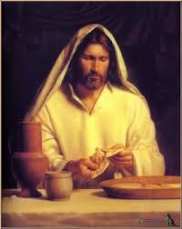
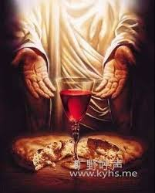
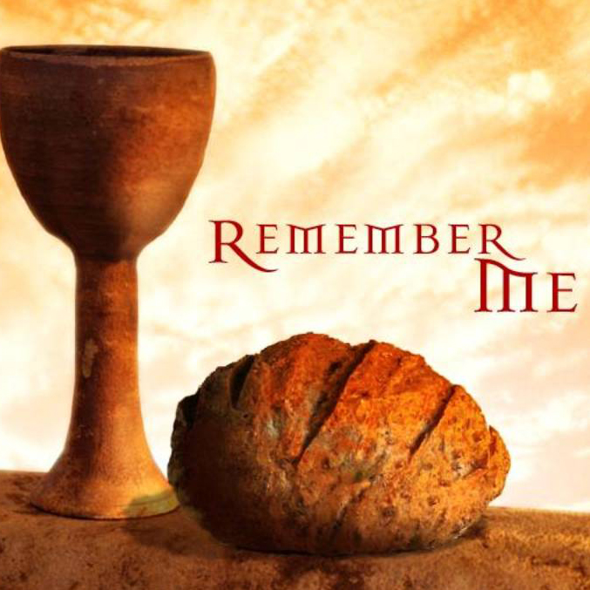
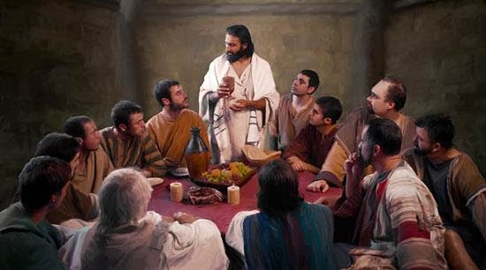
Holy Communion
圣餐

Slide 33
COMMUNION Prayer 聖餐禱告
But you, O Lord, are unchanging in Your mercy, and Your nature is love; grant us, therefore, God of mercy, God of grace, so to eat at this Your table that we may receive in spirit and in truth the body of Your dear Son, Jesus Christ, and the merits of His shed blood, so that we may live and grow in His likeness, and, being washed and cleansed by His most precious blood, we may evermore live in Him and He in us. Amen
慈悲憐憫的主啊，祢的慈愛永不改變，祢的本性就是愛。求祢施恩，使我們來到祢的聖桌前，憑著真誠的信心領受祢愛子耶穌基督的身體，並因祂所流的寶血得蒙救贖。願我們越來越有基督的樣式，藉著祂寶血的洗淨，常住在祂裡面，祂也常住在我們裡面。阿們。

Slide 34
COMMUNION 聖餐
In the night of his betrayal, Jesus took bread, and when He had given thanks, He broke it and gave it to His disciples, saying, “Take, eat; this is My body which is given for you; do this in remembrance of Me. In like manner, after supper He took the cup, and when He had given thanks, He gave it to them, saying, “Drink of this, all of you, for this is My blood of the New Testament, which is shed for you and for many, for the forgiveness of sins; do this as often as you drink it, in remembrance of Me.
主耶穌被賣的那一夜，拿起餅來，祝謝了，就擘開，說，你們拿著吃，這是我的身體，為你們捨的，你們應當如此行，為的是紀念我。飯後，又拿起杯來，祝謝了，遞給他們說，你們都要喝，這杯是我立新約的血，為你們和眾人免罪流的，你們每逢喝的時候，要如此行，為的是紀念我。阿們。

Slide 35
COMMUNION 聖餐
The body of our Lord Jesus Christ, which was given for you, preserve your soul and body onto everlasting life. Take and eat this in remembrance that Christ died for you, and feed upon Him in your heart, by faith with thanksgiving.
基督的身體，為你捨了。願主耶穌基督的身體保守你的身、心、靈直到永生。你當憑著信心領受，並存感恩的心，記念基督為你捨命。

Slide 36
COMMUNION 聖餐
The blood of our Lord Jesus Christ, which was shed for you, preserve your soul and body unto everlasting life. Drink this in remembrance that Christ’s blood was shed for you, and be thankful.
基督的寶血，為你流出。願主耶穌基督的寶血保守你的身、心、靈直到永生。你當存感恩的心領受，記念基督為你的罪流血。

Slide 37
PRAYER 禱告
May the peace of God which passes all understanding, keep your hearts and minds in the knowledge and love of God, and of his Son, Jesus Christ, our Lord. And may the blessing of God Almighty, the Father, the Son, and Holy Spirit, be yours now and forever more. Amen.
願賜平安的神，將那超越人所能理解的平安，
保守你們的心懷意念，使你們常存對神和祂愛子──我們主耶穌基督──的認識與愛。
願全能的神，聖父、聖子、聖靈，賜福你們，
與你們同在，從今時直到永永遠遠。阿們。

